Slide 1
TechExcel: Implementing DevOps practices to accelerate developer productivity
Day Two
Notes:
Important notes:
Links to lab/exercises on GitHub
https://github.com/microsoft/TechExcel-Implementing-DevOps-practices-to-accelerate-developer-productivity-code
https://github.com/microsoft/TechExcel-Implementing-DevOps-practices-to-accelerate-developer-productivity
Hybrid subscription WIKI Hybrid Subscription - Overview (azure.com)

Slide 2
Exercise four
Implement load testing and secure practices
Notes:
Speaker’s Notes:
SAY:
Just as we did in day 1, we talked about the lab exercises before actually doing the exercises. Before breaking into your teams, let’s talk about exercises 4 and 5.

Slide 3
Performance testing benefits
Helps to maintain systems properly and fix defects before problems reach system users.
Helps to maintain the efficiency, responsiveness, scalability, and speed of applications when compared with business requirements.
Provides diagnostic information necessary to eliminate bottlenecks, which lead to poor performance.
Prevents a bottleneck from occurring when data flow is either interrupted or stopped due to insufficient capacity to handle the workload.
Notes:
Performance testing - Microsoft Azure Well-Architected Framework | Microsoft Learn
Speaker’s Notes:
Performance testing helps to maintain systems properly and fix defects before problems reach system users.
It helps maintain the efficiency, responsiveness, scalability, and speed of applications when compared with business requirements.
When done effectively, performance testing should give you the diagnostic information necessary to eliminate bottlenecks, which lead to poor performance.
A bottleneck occurs when data flow is either interrupted or stops due to insufficient capacity to handle the workload.

Slide 4
Performance testing – best practices
Commit time and resources to test system performance.
Plan for a load buffer to accommodate random spikes without overloading the infrastructure.
Plan for and maintain a testing infrastructure. You can use a cloud-based tool, such as Azure Load Testing, to abstract the infrastructure needed to run your performance tests.
Notes:
Performance testing - Microsoft Azure Well-Architected Framework | Microsoft Learn
Speaker’s Notes:
To avoid experiencing poor performance, commit time and resources to testing system performance. Two subsets of performance testing—load testing and stress testing—can determine the upper (close to capacity) limit and maximum (point of failure) limit, respectively, of the application's capacity. By performing these tests, you can determine the necessary infrastructure to support the anticipated workloads.
A best practice is to plan for a load buffer to accommodate random spikes without overloading the infrastructure. For example, if a normal system load is 100,000 requests per second, the infrastructure should support 100,000 requests at 80% of total capacity (that is, 125,000 requests per second). If you anticipate that the application will continue to sustain 100,000 requests per second, and the current Stock Keeping Unit (SKU) introduces latency at 65,000 requests per second, consider upgrading your product to the next higher SKU. If there's a secondary region, you must ensure that it also supports the higher SKU.
Depending on the scale of your performance test, you must plan for and maintain a testing infrastructure. You can use a cloud-based tool, such as Azure Load Testing, to abstract the infrastructure needed to run your performance tests.

Slide 5
Different types of performance testing
Establish baselines
Load testing
Stress testing
Multi-region testing
Notes:
Performance testing - Microsoft Azure Well-Architected Framework | Microsoft Learn
Speaker’s Notes:
Highlight various types of performance testing
Establish baselines
Baselines help to determine the current efficiency state of your application and its supporting infrastructure. Baselines can provide good insights for improvements and determine if the application is meeting business goals. Baselines can be created for any application regardless of its maturity.
First, establish performance baselines for your application. Then, establish a regular cadence for running the tests. Run the test as part of a scheduled event or part of a continuous integration (CI) build pipeline.
No matter when you establish the baseline, measure performance against that baseline during continued development. When code or infrastructure changes, the effect on performance can be actively measured.
Load testing
Load testing measures system performance as the workload increases. It identifies where and when your application breaks so you can fix the issue before shipping to production. It does so by testing system behavior under typical and heavy loads.
Load testing takes places in stages of load. These stages are usually measured by virtual users (VUs) or simulated requests, and the stages happen over given intervals. Load testing provides insights into how and when your application needs to scale to continue meeting your SLA to your customers, both internal and external. Load testing can also be useful for determining latency across distributed applications and microservices.
Consider the following key points for load testing:
Know the Azure service limits: Different Azure services have soft and hard limits associated with them. The terms soft limit and hard limit describe the current, adjustable service limit (soft limit) and the maximum limit (hard limit). Understand the limits for the services you consume so that you aren't blocked if you need to exceed them. For a list of the most common Azure limits, see Azure subscription and service limits, quotas, and constraints.
The ResourceLimits sample shows how to query the limits and quotas for commonly used resources.
Measure typical loads: Knowing the typical and maximum loads on your system helps you understand when something is operating outside of its designed limits. Monitor traffic to understand application behavior.
Understand application behavior under various scales: Load test your application to understand how it performs at various scales. First, test to see how the application performs under a typical load. Then, test to see how it performs under load using different scaling operations. To get more insight into how to evaluate your application as the amount of traffic sent to it increases, see Autoscale best practices.
Stress testing
Unlike load testing, which ensures that a system can handle what it's designed to handle, stress testing focuses on overloading the system until it breaks. A stress test determines how stable a system is and its ability to withstand extreme increases in load. For example, it can test the maximum number of requests from another service that a system can handle at a given time before performance is compromised and fails. Find this maximum to understand what kind of load the current environment can adequately support.
Determine the maximum demand you want to place on memory, CPU, and disk IOPS. After a stress test has been performed, you know the maximum supported load and an operational margin. It's best to choose an operational threshold so that scaling can be performed before the threshold has been reached.
Once you determine an acceptable operational margin and response time under typical loads, verify that the environment is configured adequately. To verify the configuration, make sure the SKUs that you selected are based on the desired margins. Be careful to stay as close as possible to your margins. Allocating too much can increase costs and maintenance unnecessarily. Allocating too few can result in a poor user experience.
In addition to stress testing through increased load, you can stress test by reducing resources to identify what happens when the machine runs out of memory. You can also stress test by increasing latency (for example, the database takes 10 times longer to reply, writes to storage takes 10 times longer, and so on).
Multi-region testing
A multi-region architecture can provide higher availability than deploying to a single region. If a regional outage affects the primary region, you can use Front Door to use the secondary region. This architecture can also help if an individual subsystem of the application fails.
Test the amount of time it would take for users to be rerouted to the paired region so that the region doesn't fail. To learn more about routing, see Front Door routing methods. Typically, a planned test failover can help determine how much time would be required to fully scale to support the redirected load.

Slide 6
Compare load and stress testing
 | Load Testing | Stress Testing
What is it? | Measures system performance as the workload increases. Identifies the capacity where and when your application breaks. Determines latency across distributed applications and microservices. | Determines how stable a system is and its ability to withstand extreme increases in load. Focuses on overloading the system until it breaks. Identifies the system’s point of failure.
Why is it performed? | This is done to be able to fix the issue before shipping to production. | This is done to find and understand what kind of load the current environment can adequately support.
How is it done? | Load testing is done by testing system behavior under typical and heavy loads. | Stress testing is done by increasing the load as well as reducing resources to identify what happens when the machine runs out of memory or with increased latency.
What is the impact on the user? | Takes place in stages of load, usually measured by virtual users (VUs) or simulated requests. Happens over given intervals to provide insights into how and when your application needs to scale to continue meeting your SLA for your internal and external customers. | Determine the maximum demand you want to place on memory, CPU, and disk IOPS. After a stress test has been performed, you know the maximum supported load and an operational margin to perform scaling before the threshold has been reached. Allocating too high increases cost and allocating too low negatively impacts user experience.
Notes:
Performance testing - Microsoft Azure Well-Architected Framework | Microsoft Learn
Load Testing - Microsoft Azure Well-Architected Framework | Microsoft Learn
What is Azure Load Testing? | Microsoft Learn
Speaker’s Notes:
From ChatGPT (TBD)
In summary, load testing is focused on assessing performance under normal or expected conditions, ensuring the system can function optimally within these parameters.
Stress testing, on the other hand, aims to evaluate how the system behaves beyond its capacity, helping to understand failure points and its behavior under extreme circumstances.

Slide 7
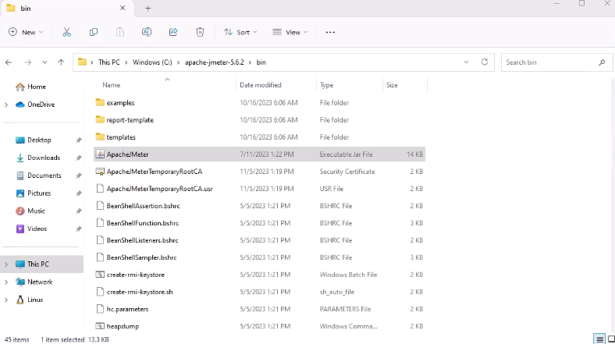
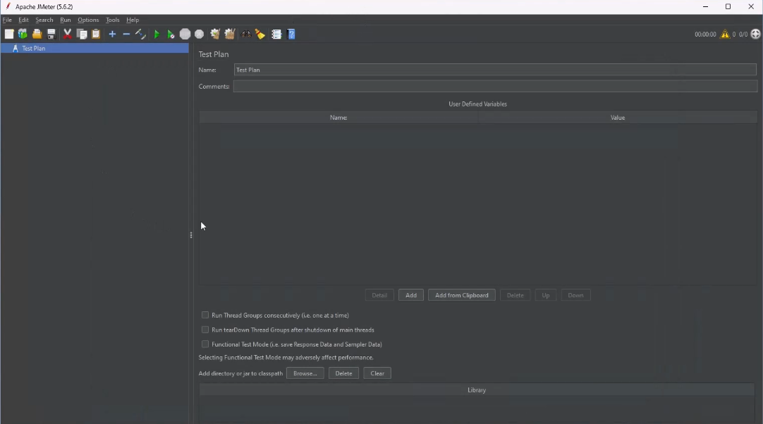
JMeter demo video
JMeter demo video link
Notes:
Speaker’s Notes:
SAY:
A demo video on JMeter testing is available. You may wish to access it before Exercise 4 tomorrow.

Slide 8
Exercise five
Make things secure

Slide 9

The benefits of DevSecOps
Reduce remediation time by shifting security left
MORE SECURE CODE, SHIPPED AT THE SAME SPEED
Integrate with and secure your existing toolchains
DevOps Definition (Development + Operations)
DevSecOps Definition (Development + Security + Operations)
DevOps is the union of people, processes, and technology to deliver continuous value to users.
DevSecOps is an evolution in the way development organizations approach security by introducing a security-first mindset culture and automating security into every phase of the software development lifecycle from design to delivery.
Quickly identify new threat vectors
Notes:
Speaker’s notes:
SAY:
You may be familiar with how DevOps practices and collaboration between developer and operations teams led to faster software delivery. DevOps combines people, processes, and technology to deliver continuous value to users.
DevSecOps is the evolution of DevOps where the company takes on a security-first mindset — putting security into every phase of the development lifecycle, from design to delivery.
When implemented successfully, companies gain both the speed of DevOps development practices and the holistic security and peace of mind that comes with DevSecOps. This helps organizations:
Reduce remediation time by shifting security left
Integrate with and secure your existing toolchains
And quickly identify new threat vectors

Slide 10





Develop apps securely with a unified solution from Microsoft
Dev
VSCode.Dev
GitHub Advanced Security
Code scanning
Secret scanning
Dependency scanning
GitHub Repo
GitHub Actions
Azure Container Registry
Azure
Codespaces
SecOps
Secure ARM Templates
Azure Security Center
Secure Azure Policy
Azure Secure Score
Azure Defender
WAF / DDoS
Azure Firewall
Azure
AD
App Config
Azure Monitor
Sentinel
Azure Key Vault
Notes:
Speaker’s notes:
SAY:
Microsoft’s unified DevSecOps solution relies on two main components:
Making sure we are securing the developer workflow as code is being created
Security operations, which tends to the code after it’s deployed in production.
Let’s dig into the development section first. We have an extensive solution thanks to GitHub and Azure’s combined forces.
Visual Studio Code: Provides a virtual development environment for any developer regardless of their local capabilities
Same goes for GitHub Codespaces capabilities: It’s essentially an entire development lifecycle tool that’s in the cloud, that’s makes it super easy to onboard new developers to your team, and work with contractors or third parties. It also has a lot of built-in intellectual property protection capabilities. This is because code is no longer being dispersed into multiple locations.
Additional components like GitHub Repos and GitHub Actions — really help our customers deploy the code they want to, wherever they want.
Finally, we have security guidance and continuous feedback through GitHub Advanced Security, which includes code scanning, secret scanning, and dependency scanning.
We’ve also compiled a strong, unified set of SecOps tools that help proactively defend against threats:
For identity management services, use Azure AD to instill zero-trust security throughout your organization
Leverage Azure Policy and Azure Key Vault to systematically apply policies across applications and projects while storing secrets outside of your code.
With Azure Security Center you have all the tools necessary to anticipate and remediate threats wherever your applications live.
And with Azure Sentinel, your enterprise has access to intelligent, security analytics that allow you to view a birds-eye-view across your organization.
All these capabilities fully integrate with one another and deployed together in Azure, making this a complete, unified solution for secure development.

Slide 11

Secure software development with DevSecOps
GitHub
Azure
Secure your development environment
Embed security in your developer workflow
Bridge the divide across DevOps and SecOps teams
Notes:
Speaker’s notes:
SAY:
This unified DevSecOps solution makes it easier for organizations to realize the core DevSecOps benefits of:
Bridging the divide across DevOps and SecOps teams
Securing your development environments
And easily allows you to embed security in your developer workflow
Let’s dive into each of these topics a little further.

Slide 12

Secure your development environment
Notes:
Speaker’s notes:
SAY:
Next, let's discuss securing the development environment…

Slide 13
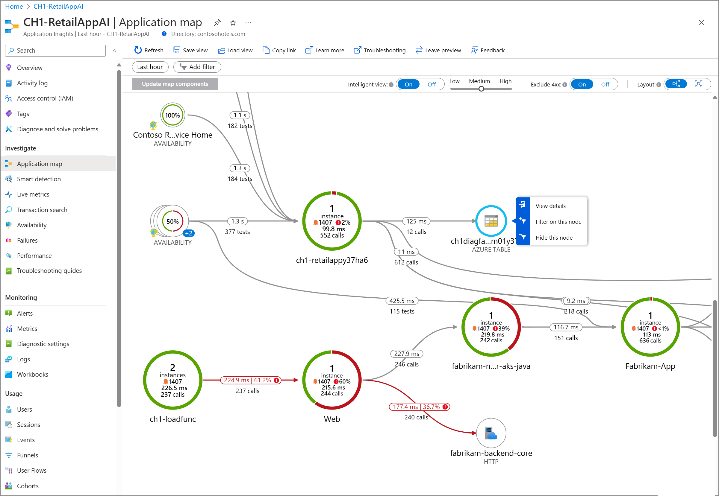
Application Insights overview
Azure Monitor Application Insights, a feature for Azure Monitor, excels in Application Performance Management (APM) for live web applications.
Notes:
Application Insights overview - Azure Monitor | Microsoft Learn
Speaker’s notes:
Experiences
Investigate
Usage
Code analysis
Logic Model
Supported languages

Slide 14
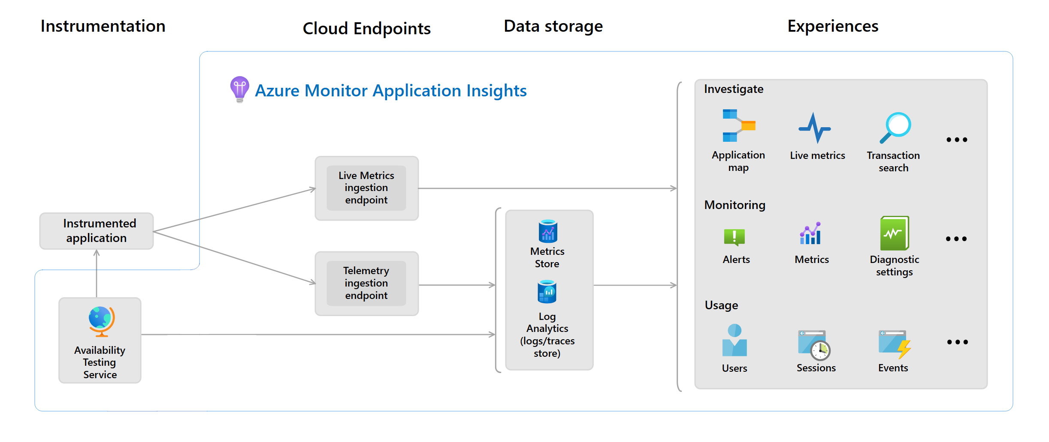
Application Insights overview – the Logic Model
The Logic Model diagram visualizes components of Application Insights and how they interact.
Notes:
Application Insights overview - Azure Monitor | Microsoft Learn
Speaker’s notes:

Slide 15
Exercise three: improve and deploy your application (part two)
Notes:
Speaker’s notes:
Display the slide to signal the start of Exercise 3.
Inform students that only the first two tasks in Exercise 3 will be completed in Day 1. The remaining two tasks will be completed in Day 2.
Exercise 3 will be debriefed when Exercise 3 is completed.

Slide 16
Introductions: improve and deploy your application
In this exercise, you’ll deploy Azure resources and introduce CI/CD pipelines to your GitHub repo.
After completing this exercise, you’ll be able to:
Configure GitHub Copilot and use it to assist with C# code changes.
Deploy ARM and Bicep templates via GitHub Actions workflow.
Create a GitHub Actions workflow for deploying .NET web applications.
Automatically build and deploy a Docker image as part of a workflow.
Update an Azure Web App whenever the GitHub Actions workflow deploys a new Docker image.
Notes:
Speaker notes:
SAY:
You've created a GitHub repository containing application code and a Bicep script. In this exercise, you will create resources in an Azure resource group, including an App Service Plan, three App Services, one Application Insights service, and one Container Registry. You will also use GitHub Copilot in Visual Studio Code to assist you with making a change to the Team Messaging System.
After deploying Azure resources, you will create a new GitHub Actions workflow that builds and deploys a Docker container image based on the .NET web application code. Then, whenever the application code changes, you will build a new image, deploy it to the Container Registry, and use that new image in your App Services.
Learning objectives
After completing this exercise, you'll be able to:
Configure GitHub Copilot and use it to assist with C# code changes
Deploy ARM and Bicep templates via GitHub Actions workflow
Create a GitHub Actions workflow for deploying .NET web applications
Automatically build and deploy a Docker image as part of the workflow
Update an Azure Web App whenever the GitHub Actions workflow deploys a new Docker image
Speaker’s Notes:
Inform students that the instructions for completing the exercises are in the GitHub link TBD.
Proceed with the exercise.

Slide 17




Exercise three architecture
Munson’s Pickles & Preserves application architecture
App Service Plan
App Insights
App Service (Dev)
App Service (Test)
App Service (Prod)
Container Registry
Notes:
Speaker’s notes:
SAY:
This exercise will focus on deploying the Munson’s Pickles and Preserves Team Messaging System application into Azure.

Slide 18
Deploy a Bicep template
GitHub allows you to execute ARM and Bicep templates as part of a GitHub Actions workflow.
To deploy resources, you will need to log into Azure and then use the arm-deploy action.
- uses: azure/login@v1
with:
creds: ${{ secrets.AZURE_CREDENTIALS }}
- name: Run ARM deploy
uses: azure/arm-deploy@v1
with:
subscriptionId: ${{ secrets.AZURE_SUBSCRIPTION_ID }}
resourceGroupName: ${{ secrets.AZURE_RG }}
template: ./InfrastructureAsCode/main.bicep
parameters: environment=${{ github.event.inputs.appenv }}
The action above will deploy a file called main.bicep to Azure whenever the GitHub Actions workflow runs.
Notes:
Speaker notes:
SAY:
GitHub allows you to execute ARM and Bicep templates as part of a GitHub Actions workflow. To do this, you can use the azure/arm-deploy action from the GitHub Marketplace. It needs several parameters, including a subscription ID, a resource group name, the location of the ARM or Bicep template file, and a set of input parameters.
The arm-deploy action can work with both ARM and Bicep templates because Bicep is fully translatable into ARM.
You will create a GitHub Actions workflow to perform this operation. In practice, this would allow you to automate resource changes whenever the Bicep template changes, automating your Infrastructure as Code process.

Slide 19
CI/CD for .NET websites with GitHub actions
Create another GitHub Actions workflow for deploying the website
steps:
- uses: actions/checkout@v3
- name: Setup .NET
uses: actions/setup-dotnet@v3
with:
dotnet-version: 6.0.x
- name: Restore dependencies
run: dotnet restore
- name: Build
run: dotnet build --no-restore
- name: Test
run: dotnet test --no-build
Create a GitHub Actions .NET workflow and configure each of the steps.
Add environment variables to manage deployment.
Build a Docker image from the .NET code and deploy it to Azure Container Registry. Then, update the Web App with that new container image.
Notes:
Speaker notes:
SAY:
The final step in this exercise is to create a Continuous Integration and Continuous Delivery (CI/CD) process for deploying the .NET website. You will use yet another GitHub Actions workflow, this one based around .NET CI/CD. The core of this workflow includes three commands: dotnet restore to restore any dependencies in NuGet packages, dotnet build to compile the application and create binaries, and dotnet test to run unit tests against the compiled binaries.
In addition, you will extend this workflow to build a Docker image from the .NET code and deploy it into an Azure Container Registry. Then, for each newly tagged image, you will update each environment’s Web App with that container image.

Slide 20
Exercise three summary Improve and deploy your application
In this exercise you:
Configured GitHub Copilot and used it to assist with C# code changes.
Deployed ARM and Bicep templates via GitHub Actions workflow.
Created a GitHub Actions workflow for deploying .NET web applications.
Automatically built and deployed a Docker image as part of a workflow.
Updated an Azure Web App whenever the GitHub Actions workflow deploys a new Docker image.
Notes:
Speaker’s Notes:
After the team completes exercise 3, briefly go through the list of tasks covered in the exercise as a form of review.

Slide 21


Debrief exercise three
Reflection and discussion points
After completing the exercise, take some time to reflect on the core concepts you've learned, including the role of GitHub Copilot, the principles of IaC, and the benefits of CI/CD.
Consider how the exercise content and skills can be applied in real-world scenarios and your current or future projects. Think about potential use cases.
Share your experiences, insights, and any difficulties you faced during the exercise. What was the most challenging part? What did you find interesting or valuable?
If there were concepts or steps that you found confusing or challenging, use this opportunity to ask questions and seek clarification from the coach.
If you have ideas for improving the exercise content or processes related to GitHub Copilot, IaC, or CI/CD, don't hesitate to offer suggestions during the discussion.
Notes:
Speaker’s Notes:
These questions are available in the Student’s guide as well.
If you are short on time, have students select one reflection or discussion point they would like to answer.

Slide 22
Exercise four: implement load testing and secure practices
Notes:
Speaker’s notes:
Display the slide to signal the start of Exercise 4
Plan a Java application migration to Azure Kubernetes Services is the first exercise is a series of eight labs spanning three days.
This first exercise is a mix of conceptual information and explanation the hands-on activities meant to set the stage for migrating apps, monitoring, and security.
Encouraged students to share ideas, strategies, and what works with their fellow students.
Reinforce that the labs are mostly self-driven by the students and full of opportunities for students to help students. The team lead and coach’s role is to guide the students through the labs and assist them through setbacks.
Perhaps review the Prerequisites
Basic Git commands, including cloning, committing files, and pushing changes to GitHub,
Developing scalable solutions through all phases of software development,
Java and Spring Boot development (recommended),
Azure cloud concepts, services, and the Azure portal,
Basic understanding of application containerization and Kubernetes,
Familiarity with Azure and other tools, including installation: Apache Maven (recommended)

Slide 23
Introductions: implement load testing and secure practices
In this exercise, you’ll create an Apache JMeter load test, use this load test in an Azure Load Test service, and design a chaos experiment using Azure Chaos Studio.
After completing this exercise, you’ll be able to:
Design a load test for a web application.
Create a load test using Apache JMeter.
Create an Azure Load Testing service and execute the JMeter load test in Azure.
Design and create a stress test using the Azure Load Testing service.
Design a chaos experiment in Azure Chaos Studio.
Notes:
Speaker notes:
SAY:
Now that the Team Messaging System website is up and running, it would be beneficial to understand how well the application performs under load. To do this, you will design a load test scenario and then implement it using Apache JMeter, an open source solution for load testing.
After running the load test manually, you will create an Azure Load Testing service. The Load Testing service supports importation of JMeter scripts, so you will be able to use the work you’ve created so far and create a performance baseline for the application. You may also be able to observe performance issues in particular actions, which you can remedy.
After that, you will extend the load test to become a stress test, attempting to push enough traffic at the website to generate failure. You will also use Azure Chaos Studio to generate a chaos experiment, learning how the application behaves when certain services fail.
Learning objectives
After completing this exercise, you'll be able to:
Design a load test for a web application
Create a load test using Apache JMeter
Create an Azure Load Testing service and execute the JMeter load test in Azure
Design and create a stress test using the Azure Load Testing service
Design a chaos experiment in Azure Chaos Studio
Speaker’s Notes:
Inform students that the instructions for completing the exercises are in the GitHub link TBD.
Proceed with the exercise.

Slide 24


Exercise four architecture
Munson’s Pickles & Preserves application architecture
App Service Plan
App Insights
Chaos Experiment
App Service (Dev)
App Service (Test)
App Service (Prod)
Container Registry
Load Testing
Notes:
Speaker’s notes:
SAY:
This exercise will focus on extending the current Azure solution to include load testing and Azure Chaos Studio.

Slide 25
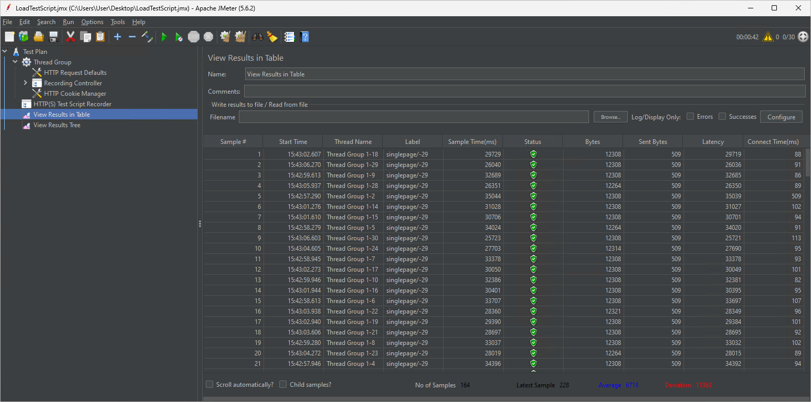
Build and run a load test
Apache JMeter is an open source tool for building and running load test scripts.
Apache JMeter
A load test allows us to simulate a certain amount of traffic against an application to ensure that the application can handle that level of load.
Notes:
Speaker notes:
SAY:
Apache JMeter is an open source tool for building and running load test scripts. It requires Java 8 or later to be installed and was one of the tools you installed on your Dev Box. You will be able to build a load test using the JMeter GUI, after which you can either run the test in the GUI itself or via command line.
These load tests allow us to simulate a certain amount of traffic against an application. You will design the test and specify how many concurrent users will run this workload. The intent is to ensure that the App Service you created will be able to handle a certain amount of traffic without failure.

Slide 26
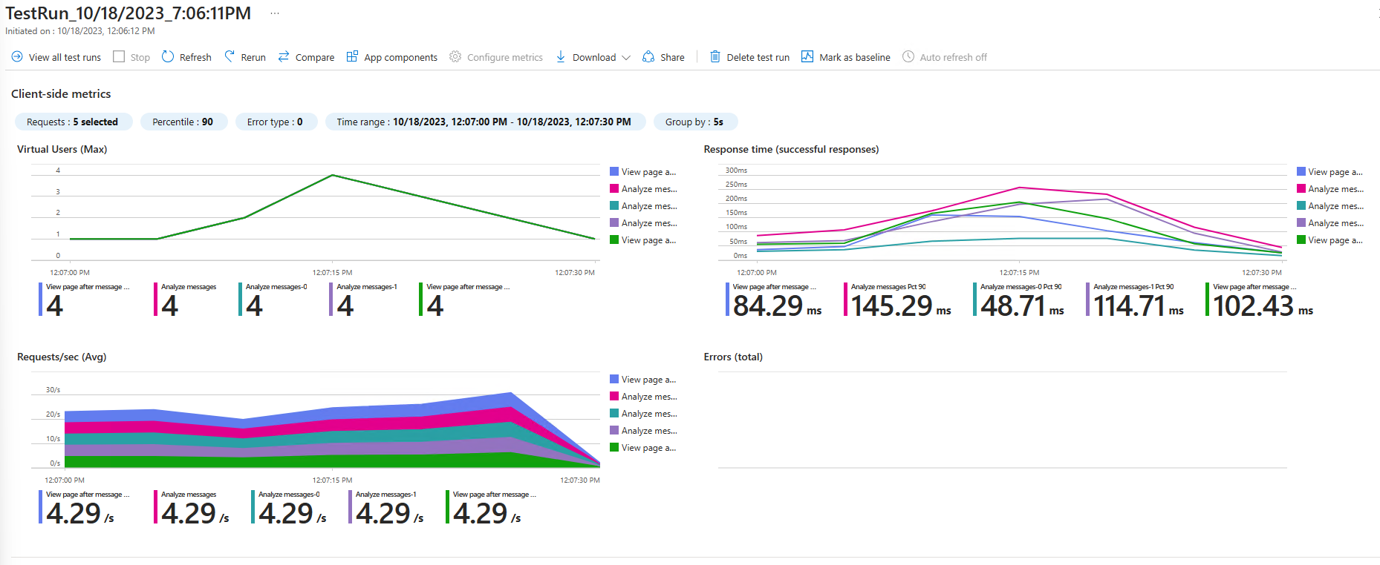
Working with Azure load testing
Notes:
Speaker notes:
SAY:
In addition to running load tests directly via JMeter, you will also create an Azure Load Testing service and run load tests from it. Azure Load Testing accepts JMeter scripts, so you can use the script you have already created as the basis for additional testing. This will provide you with additional information on response times and allow you to link your load test to specific Azure resources and see how the level of load affects those services.
For this exercise, you will link the load test to your App Service.

Slide 27
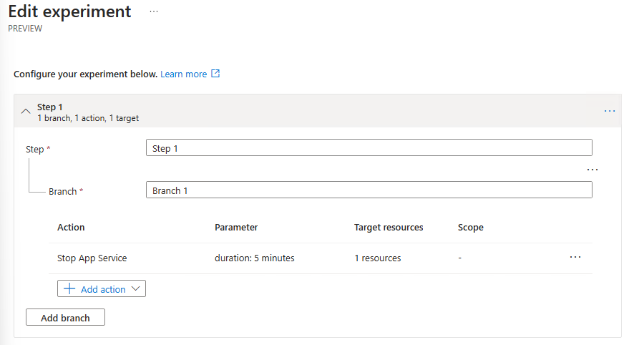
Build an Azure Chaos experiment
You’ll create a chaos experiment to observe behavior when the App Service stops.
Azure Chaos Studio allows us to design experiments that disable resources and test the resiliency of applications.
During the experiment, you will run a load test to simulate activity, observing what happens when a service fails.
Notes:
Speaker notes:
SAY:
Load testing is not the only form of testing you can run in Azure. You can also run chaos experiments to simulate service failures.
Azure Chaos Studio allows you to design experiments that disable specific resources for a given amount of time. Azure Chaos Studio is currently in preview and supports a limited number of services, so for this exercise, we will stop the App Service for a fixed amount of time, seeing how it impacts a running load test.

Slide 28
Exercise four (mid-exercise check-in)
Discussion points
Share any key insights, challenges, or achievements you've experienced up to this point in the exercise. What aspects of configuring load testing have you found most interesting or difficult?
Address the tasks completed until this point, including defining the scope of testing and creating Azure Load Testing resources. Were there any challenges or discoveries during these tasks?
If you have questions or need clarification on any part of the exercise, this is a good time to ask before continuing to Part 2.
Notes:
Speaker’s Notes:
These questions are available in the Student’s guide as well.
If you are short on time, have students select one reflection or discussion point they would like to answer.

Slide 29
Exercise four summary Configure load testing
In this exercise you:
Designed a load test for a web application.
Created a load test using Apache JMeter.
Created an Azure Load Testing service and execute the JMeter load test in Azure.
Designed and created a stress test using the Azure Load Testing service.
Designed a chaos experiment in Azure Chaos Studio.
Notes:
Speaker’s Notes:
After the team completes exercise 4, briefly go through the list of tasks covered in the exercise as a form of review.

Slide 30
Debrief exercise four
Discussion points
After finishing the exercise, take a moment to reflect on the entire experience, from defining the scope to running load tests.
Share your overall takeaways, including the importance of setting test criteria, monitoring, and identifying bottlenecks.
Consider how the exercise content and skills can be applied in real-world scenarios and in your own projects.
If there are any remaining questions or aspects of the exercise that you'd like to clarify?
Do you have any suggestions on how to improve this exercise?
Notes:
Speaker’s Notes:
These questions are available in the Student’s guide as well.
If you are short on time, have students select one reflection or discussion point they would like to answer.

Slide 31
Exercise five: make things secure
Notes:
Speaker’s notes:
Display the slide to signal the start of Exercise 4.

Slide 32
Introductions: security and monitoring
In this exercise, you’ll add security to GitHub and monitoring to you application
After completing this exercise, you’ll be able to:
Configure branching in GitHub
Setup protected branches
Setup a GitHub security policy
Configure code security and vulnerability scanning
Create app monitoring dashboards
Configure app availability monitoring
Notes:
Speaker notes:
SAY:
You've created you application and setup deployments and pipelines from GitHub into your Azure Apps.
Now that you pipeline is setup, you’ll look at various configuration options including branching and code scanning in GitHub. Then you’ll look at app monitoring within Azure Application Insights.
In this task, you'll add security to your application development process.
Learning objectives
After completing this exercise, you'll be able to:
Configure branching in GitHub
Setup protection on a GitHub branch, for instance your main branch that deploys your code to your web application
Deploy GitHub security policies and cod security and vulnerability scanning solutions
Monitor your app with Application insights as well as perform availability monitoring of your application with App Insights.

Slide 33
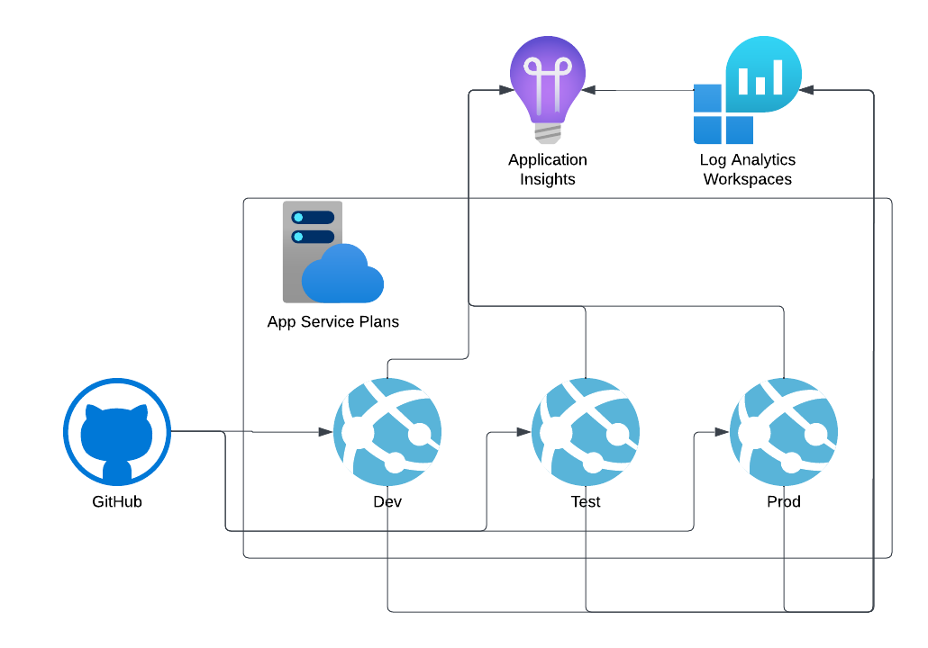
Exercise five architecture
Notes:
Speaker’s notes:
SAY:
The Tasks will focus on securing and monitoring you application deployments and GitHub.
Application code can be deployed from GitHub to Dev, Test, and/or Production within an Azure App Service Plan. When thinking about Security, you have both GitHub security to consider as well as the security of your applications.
We’ll start this exercise by looking at security measure you can take in GitHub and then look at how you can monitor you application using a Log Analytics Workspace and Application Insights.

Slide 34
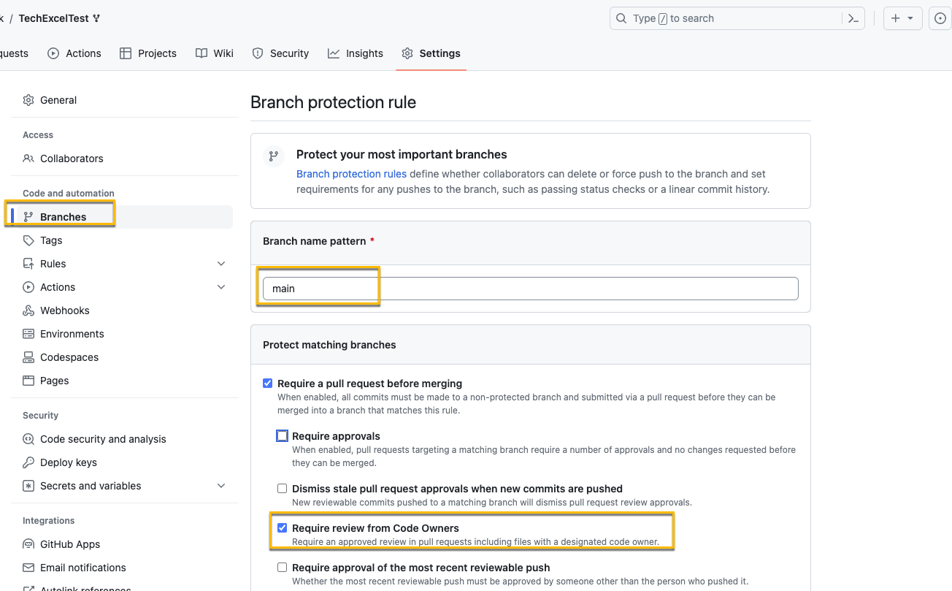
Branch policies
Branch Policies prevent committing code directly to production without review
The rule above protect the main branch and require review from Code Owners
Notes:
Speaker notes:
SAY:
Azure Branch policies are a feature in GitHub that you can leverage to help protect code from going straight from the developers machine to production. You can set this up on branches matching specific patterns or, in the case here, just set them against a single branch by setting tha pattern to the branch name.
With branch protection on, you can require reviews from code owners, approvals, and other requirements that must be met before the code is pushed to production. This puts that extra layer or protection in place on the GitHub repo to force the use of branching and enforce reviews and sign-off before code from a branch is committed to the production code.

Slide 35
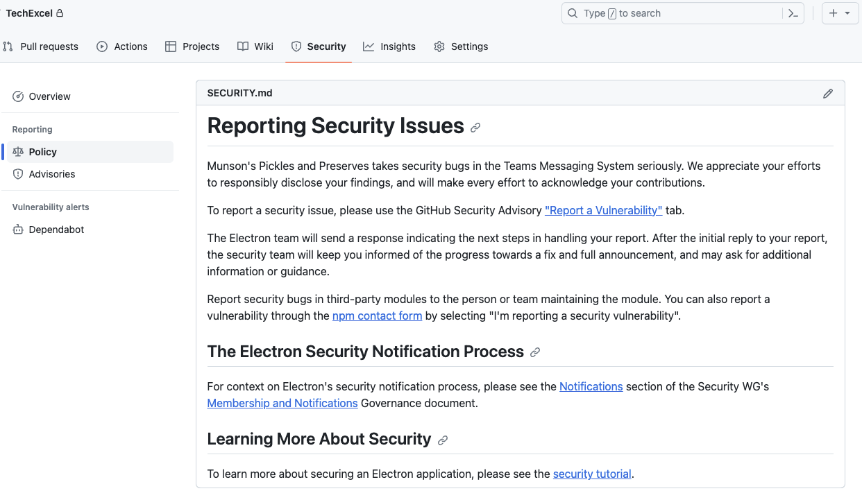
Setup a security policy for a GitHub Repo
GitHub allows you to write your own security policy in Markdown and place it into the repo to be surfaced in the security tab.
A security policy enables you to inform those accessing the repo about the security policy as well as how to handle any security issues or vulnerabilities.
Notes:
Speaker notes:
SAY:
Security policies don’t provide any security to the co pre-se, but do allow you to define what the security policy is for the particular repo. That way, if there is a security issue, developers know how to handle it and what the process is. While it shows up under Security → Policy in GitHub, it’s simple a SECURITY.md file that’s added to the code repo. The security policy can contain reporting guidelines, notification processes, and links to other security resources related to the repository.

Slide 36
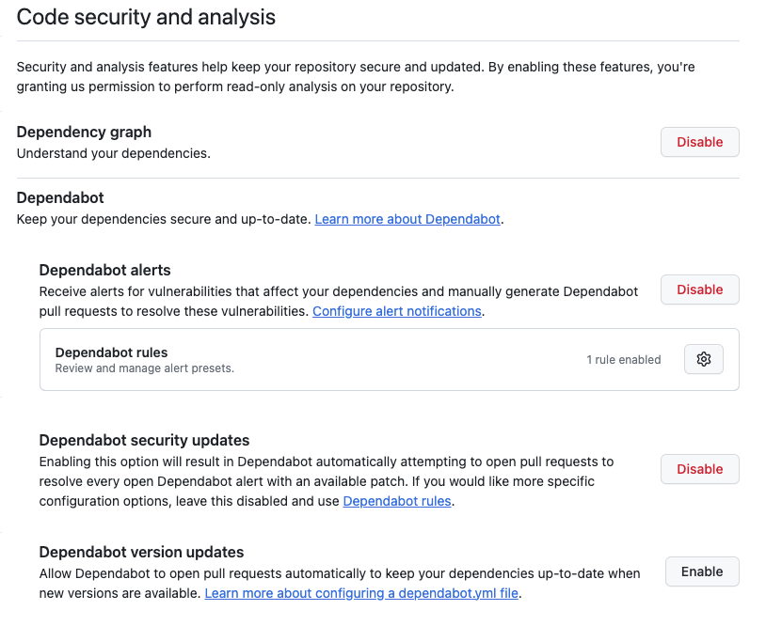
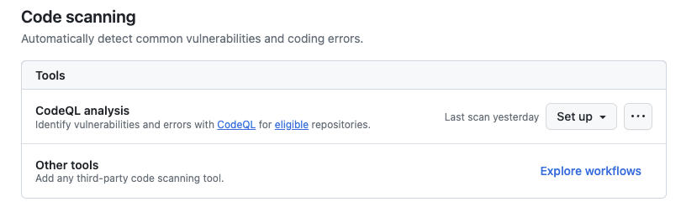
Code security and analysis
With code security and analysis, you can look for vulnerabilities. For CodeQL the repo must be public.
In this procedure, you’ll enable the following items:
Dependabot
CodeQL
Notes:
Speaker notes:
SAY:
Now that you have branch production in place to prevent code from being being published directly to production as well as a security policy defined for your users, we’ll take a look at setting up code security scanning and alerting. The two features that we’ll look at specifically are Dependabot and Code QL.
Dependabot is used to watch for any vulnerabilities related to code dependencies. Developers don’t always have the time, or even the ability to actively keep up with any vulnerabilities related to dependencies and 3rd party libraries and packages being used for their development project. By enabling Dependable alerts and rules on the GitHub repo, GitHub will watch for and alert when a dependency has a vulnerability that could affect the security of your own code. You can also configure it to not only just alert on the issues, but to also generate pull requests to update the dependencies to resolve the vulnerability.
CodeQL, while dependabot is used to help alert and manage vulnerabilities related to dependancies, CodeQL is used to analyze your own code for vulnerabilities and errors that could effect your code security. CodeQL is an open-source rep that can be used with the Advanced Security in GitHub. There are standard code scanning configurations you can use, but you can also right your own code scanning. CodeQL simply leverages a GitHub action to do things like automatically scan your code anytime there is an update committed to your repo or regular scans based on a schedule. There are some restrictions around CodeQL. If you are using a free account GitHub, you can only use CodeQL on public repos. If you want to use it on a private repo, you do need to be using a paid GitHub account.
ADDITIONAL NOTES:
Daniel Stocker question: Some advanced security features are only available inside a GitHub organization. Will participants be able to host their repo in an organization to enable these when working? If they host them in their private GitHub some options will be disabled
Kevin Feasel answer: We don't have an organization they can host in, so unless learners have their own orgs (doubtful), they will use their own private accounts and be limited in what they can see.

Slide 37
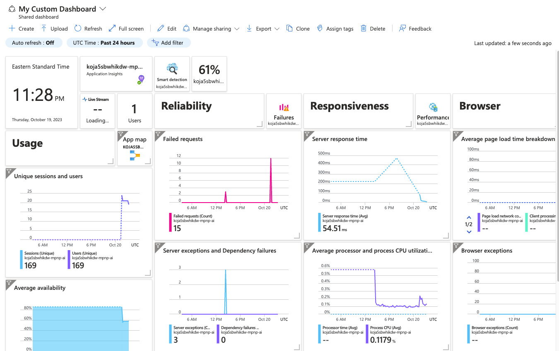
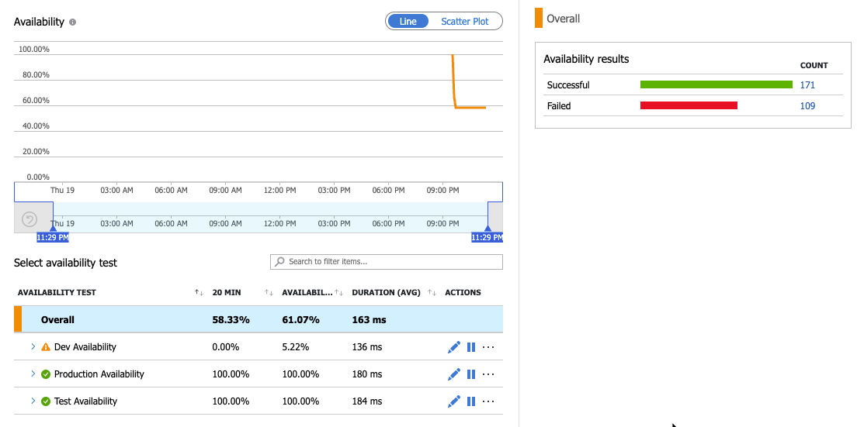
Monitor the application
With the data from the application being logged to Log Analytics, you can create dashboards and monitoring.
In this section, you’ll work with app insights
Customize the App Insights Dashboard
Setup availability monitoring
View availability alerting
Notes:
Speaker notes:
SAY:
Now that you’ve setup Security and monitoring and protecting your code, we’ll take a quick look at what you can do to monitor the application once it’s been deployed to App Services.
App Insights is the Azure Service used for monitoring applications in App Services. There used to be two ways to deploy App Insights, either with or without a Log Analytics Workspace. Microsoft has announced the end of availability for non-Log Analytics based monitoring, so any app insights instances still not converted to a Log Analytics workspace should be converted over.
App Insights gives you the ability to:
- Have a default app insights dashboard to monitor various data points about your web application
- Customize and create new dashboards so you can tailor the App Insights dashboard to your specific needs.
- Setup availability alerting to help you know, before your customers, if there is an issue with your application that causes it to go offline.

Slide 38
Exercise five summary Make things secure
In this exercise you:
Configured branching in GitHub.
Set up protected branches.
Set up a GitHub security policy.
Configured code security and vulnerability scanning.
Created app monitoring dashboards.
Configure app availability monitoring.
Notes:
Speaker’s Notes:
After the team completes exercise 5, briefly go through the list of tasks covered in the exercise as a form of review.

Slide 39
Debrief exercise five
Reflection and discussion points
What were you expected to achieve, and why are these practices important in the context of DevOps and secure development?
Did you successfully create a branch protection rule and implement security measures? Were there any challenges or discoveries along the way?
Explain the importance of creating a branch protection rule in a version control system. How does this practice contribute to code quality, collaboration, and security?
Discuss the security measures you implemented during the exercise. What security best practices did you apply, and why are they crucial in software development?
Notes:
Speaker’s Notes:
These questions are available in the Student’s guide as well.
If you are short on time, have students select one reflection or discussion point they would like to answer.

Slide 40
Debrief exercise five
Reflection and discussion points (Cont’d.)
Reinforce your understanding of the exercise's content and answer these key concept knowledge check questions:
What is the purpose of a branch protection rule in version control, and how does it benefit a development team?
What security practices did you implement during the exercise, and how do they enhance the security of your codebase?
How can monitoring tools and practices help identify and respond to security vulnerabilities and code quality issues?
Consider how the skills and practices you learned in this exercise can be applied in real-world scenarios or in your own projects. Why are these practices valuable in professional software development?
If you have any questions about branch protection, security practices, or monitoring, feel free to ask. The coach is here to provide guidance and explanations.
Notes:
Speaker’s Notes: (Reflection and discussion continuation)
These questions are available in the Student’s guide as well.
If you are short on time, have students select one reflection or discussion point they would like to answer.

